Slide 1

EXPERIMENTAL STUDY ON SMART CAMPUS SAFETY AND FEEDBACK SYSTEM
INFORMATION SCIENCE ENGINEERING
BY
ANUSHREE S
Under the guidance of
Prof. SHILPA R
(Assistant professor)
DEPARTMENT OF CIVIL ENGINEERING

Slide 2
INTRODUCTION ON SMART CAMPUS SAFETY AND FEEDBACK SYSTEM
Smart Campus Safety and Feedback System is a technology-based solution designed to ensure student safety and improve communication within the campus.
It integrates safety monitoring, emergency alert systems, and feedback collection using digital platforms.
The system helps students and staff to report issues, emergencies, and feedback in real time through mobile or web applications.
By using smart technologies, the campus becomes safer, more responsive, and well-managed.

Slide 3
OBJECTIVES OF SMART CAMPUS SAFETY AND FEEDBACK SYATEM
To enhance the safety and security of students and staff across the campus.
To provide an efficient emergency alert and monitoring system for quick response.
To enable a structured digital platform for collecting and managing feedback effectively.

Slide 4
LITERATURE REVIEW ON SMART CAMPUS SAFETY AND FEEDBACK SYSTEM
AUTHOR | YEAR | STUDY DESCRIPTION | CONCLUSION
M. Reddy, N. Lakshmi | 2020 | Designed and implemented an integrated smart campus safety system using web technologies. The system allows reporting of incidents, safety concerns, and emergencies through an online interface and sends instant notifications to administrators. | Centralized digital systems overcome limitations of manual reporting, enabling faster response and contributing to a safer campus environment.
P. Singh, R. Mehta | 2019 | Designed and implemented an integrated smart campus safety system using web technologies. The system allows reporting of incidents, safety concerns, and emergencies through an online interface and sends instant notifications to administrators. | Integrating feedback systems with safety management improves institutional responsiveness and overall campus experience.
L. Chen, Y. Wang | 2021 | Proposed a smart campus safety monitoring and feedback management system combining safety monitoring tools with feedback collection modules. Feedback and safety reports are analyzed to identify risk-prone areas. | Integrated systems help in preventive actions, sustainable campus development, and enhanced student satisfaction.

Slide 5
S. M. Almotairi, M. K. Al-Ghamdi | 2020 | Developed a smart campus security system using IoT sensors and web-based monitoring tools. The system tracks campus entrances, detects unusual activities, and alerts administrators and security personnel in real-time. | The study concluded that IoT-based monitoring significantly improves campus safety by enabling faster incident detection and proactive responses.
H. A. Al-Khalifa, F. Al-Salman | 2019 | Proposed an online student feedback system integrated with campus management, allowing students to report concerns related to safety, facilities, and academic issues anonymously. Feedback data is analyzed to prioritize corrective actions. | The research concluded that digital feedback systems enhance institutional responsiveness, improve student satisfaction, and support better decision-making for campus safety and infrastructure.

Slide 6
MATERIALS USED IN SMART CMPUS SAFETY AND FEEDBACK SYATEM
Hardware Components:
Sensors: Motion sensors, fire/smoke detectors (e.g., PIR sensor for detecting movement)
Cameras & Controllers: CCTV/IP cameras, Arduino/Raspberry Pi for processing data
Software Components:
Web Dashboard & App: For reporting incidents and sending alerts (example: a web portal for admin monitoring)
Database: MySQL or Firebase to store feedback and incident data
Network & Communication:
Connectivity: Wi-Fi/Internet to connect devices and dashboards
Notification System: SMS, email, or push alerts for emergencies

Slide 7
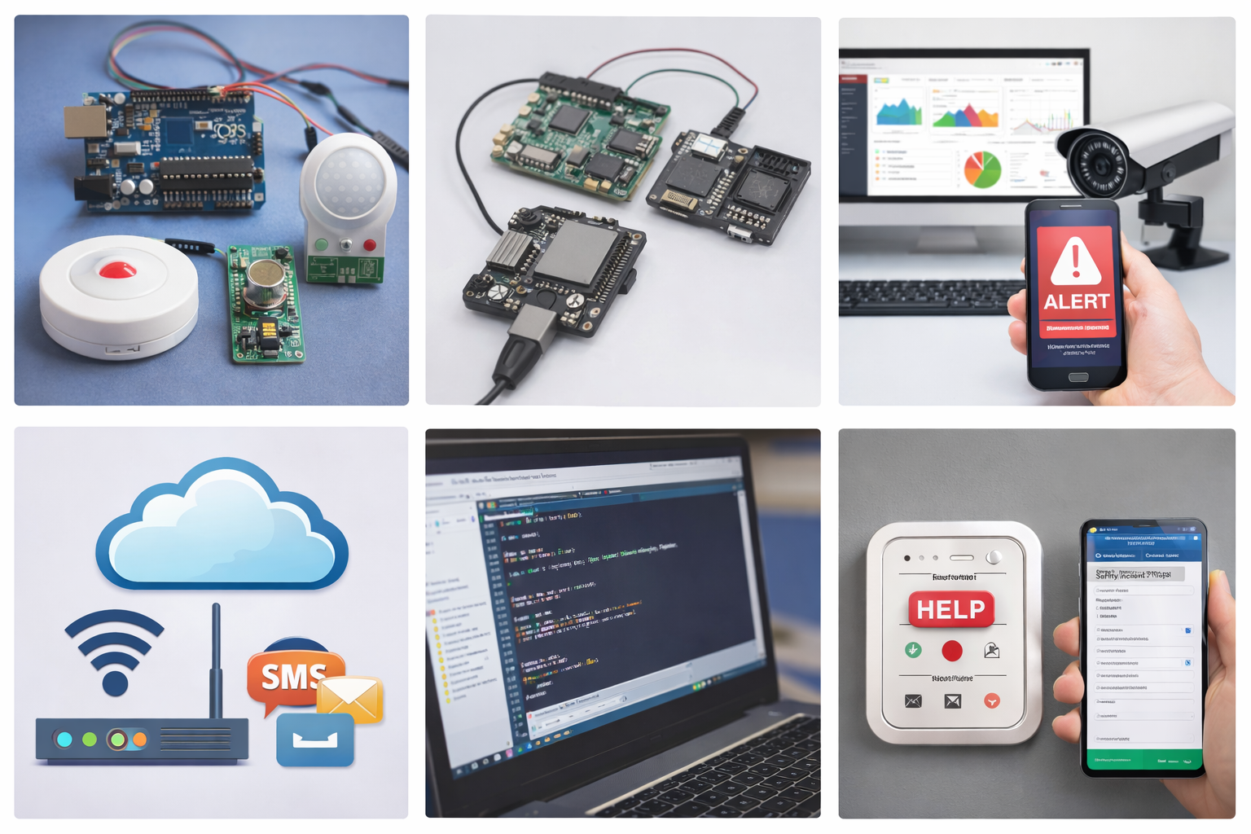
Components Used in Smart Campus Safety and Feedback System

Slide 8
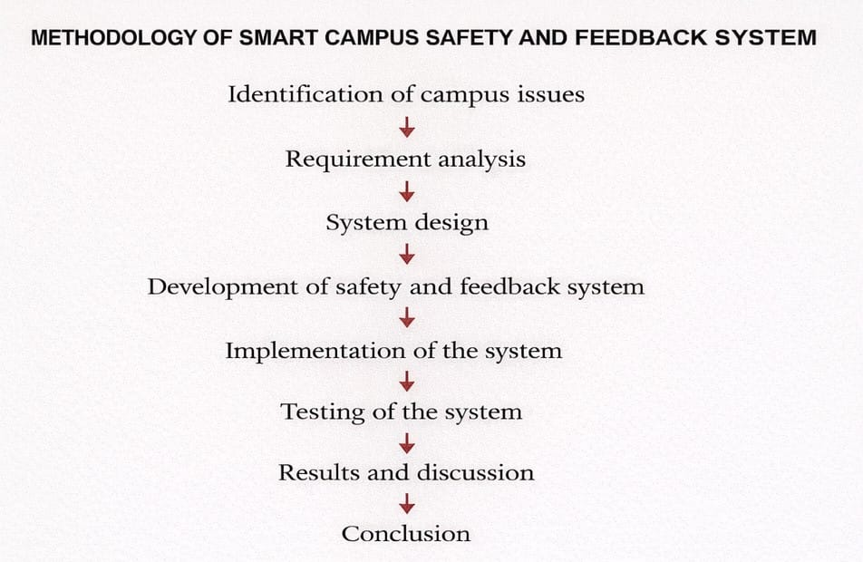

Slide 9
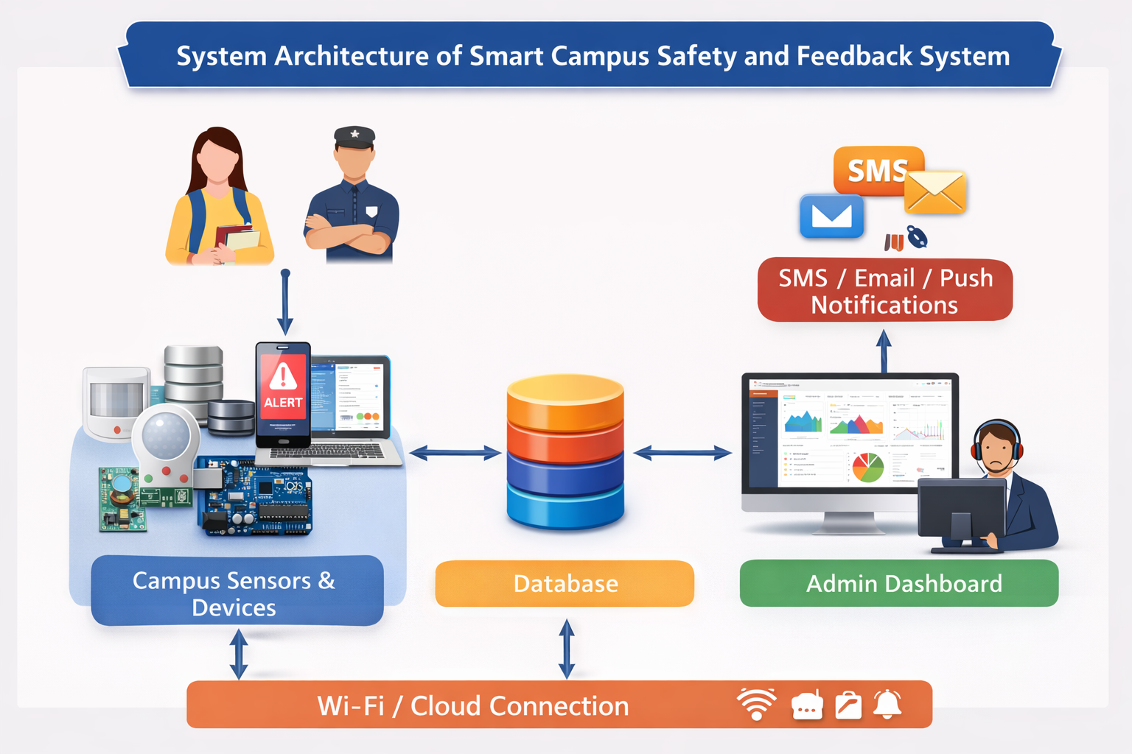
SYSTEM ARCHITECTURE

Slide 10
Modules of the System
Title: Safety Module
Real-time alerts for emergencies
Location tracking of incidents
Quick notification to campus security
Safety tips and reminders for students
Title: Feedback Module
Collect feedback from students and staff
Rating system for campus facilities
Anonymous suggestions for improvements
Reports generated for management

Slide 11
Title: Admin Module
Monitor safety alerts and notifications
Access all feedback reports
Respond to issues and suggestions
Manage users and system settings

Slide 12
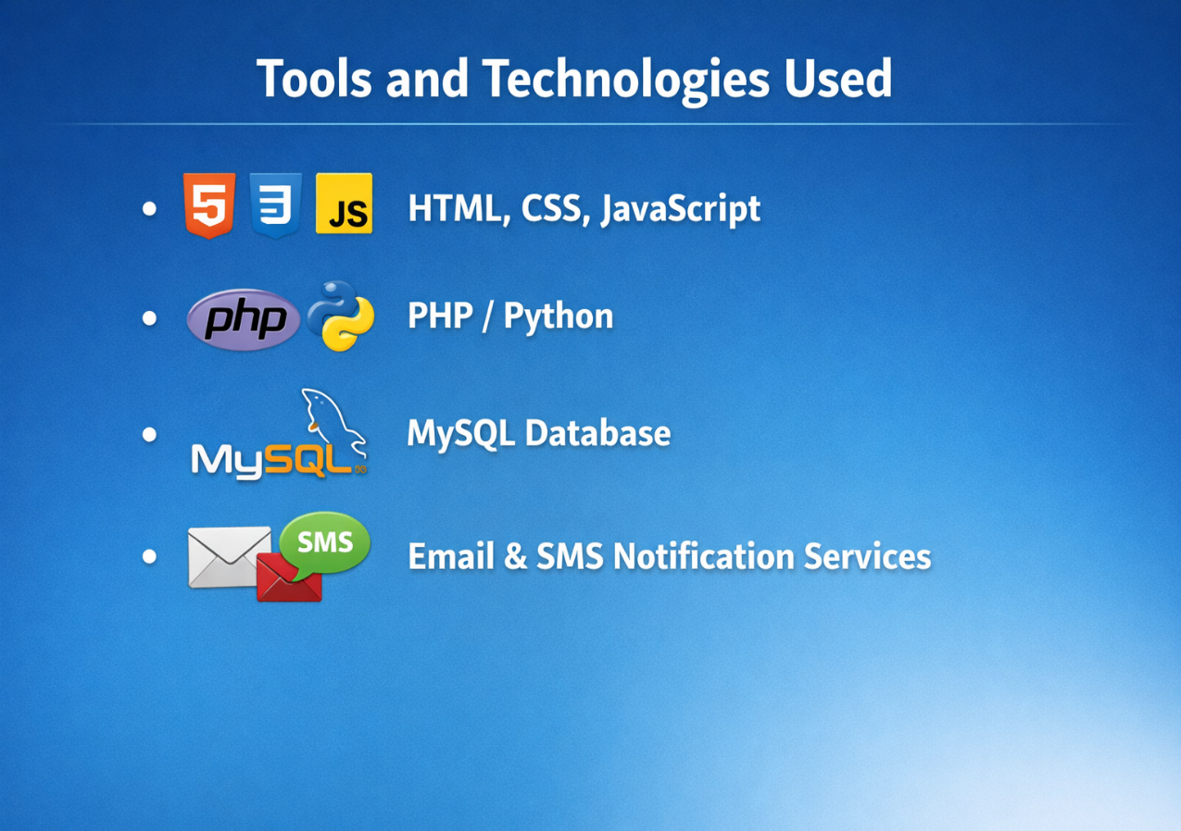
TOOLS AND TECHNOLOGIES USED
Frontend Technologies: HTML, CSS, JavaScript
Backend & Database: PHP / Python and MySQL
Notification Tools: Email and SMS alert

Slide 13
.
WORKING OF SMART SYSTEM
Step 1: User Action
The student or staff (user) logs into the system.
The user submits a safety complaint, emergency alert, or feedback through the web application.
Step 2: System Processing.
It stores the details securely in the database.
The system automatically triggers notifications (email/SMS) if it is a safety issue.
The system receives the request from the user

Slide 14
Step 3: Admin Notification
The admin/security team gets an alert with the complaint or feedback details.
The admin logs into the admin dashboard to view the reported issue.
Step 4: Admin Action
The admin analyzes the issue.
Necessary action is taken (security response, issue resolution, or acknowledgment).
The status is updated in the system (resolved / in progress).
Step 5: User Update
The user receives a confirmation or update about the action taken.
Feedback helps in improving campus safety and services

Slide 15
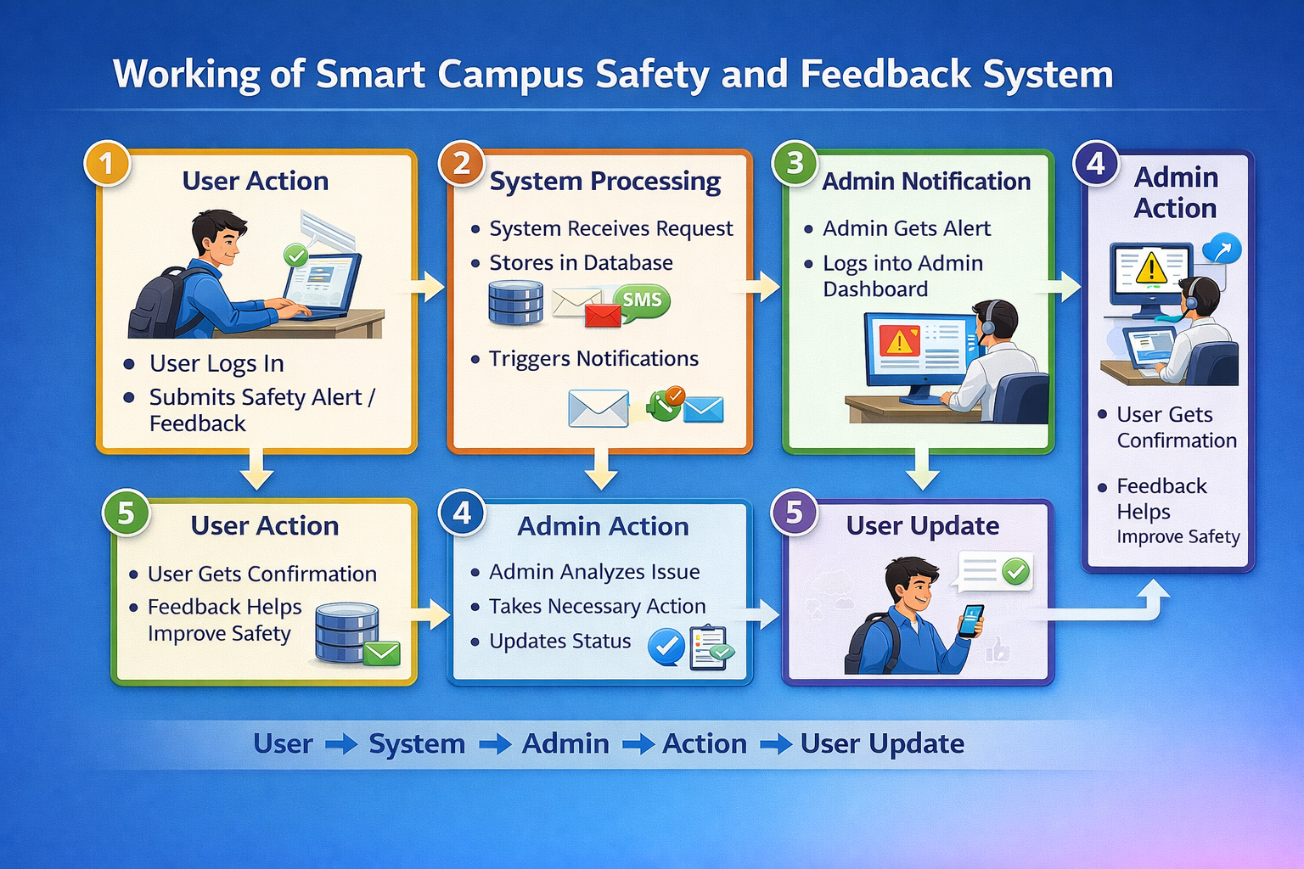

Slide 16
Advantages of Smart Campus Safety and Feedback System
Improves campus safety by enabling quick reporting of emergencies
Faster response through instant alerts to administrators
Easy and convenient reporting using an online system
Anonymous feedback option encourages honest responses
Centralized data management for safety issues and feedback
Better decision-making using stored reports and feedback analysis

Slide 17
LIMITATIONS OF SMART CAMPUS SAFETY AND FEEDBACK SYSTEMCEMENT
Requires internet connectivity
Depends on user participation
Initial setup and maintenance cost
System performance depends on hardware and software

Slide 18
APPLICATIONS
Applications of Smart Campus Safety and Feedback System
College and University Campuses – To report safety issues and collect student feedback
Hostels and Residential Areas – For emergency alerts and complaint management
School Campuses – To ensure student safety and communication
Libraries and Laboratories – To report hazards or maintenance issues
Event Management in Campuses – For crowd safety and incident reporting

Slide 19
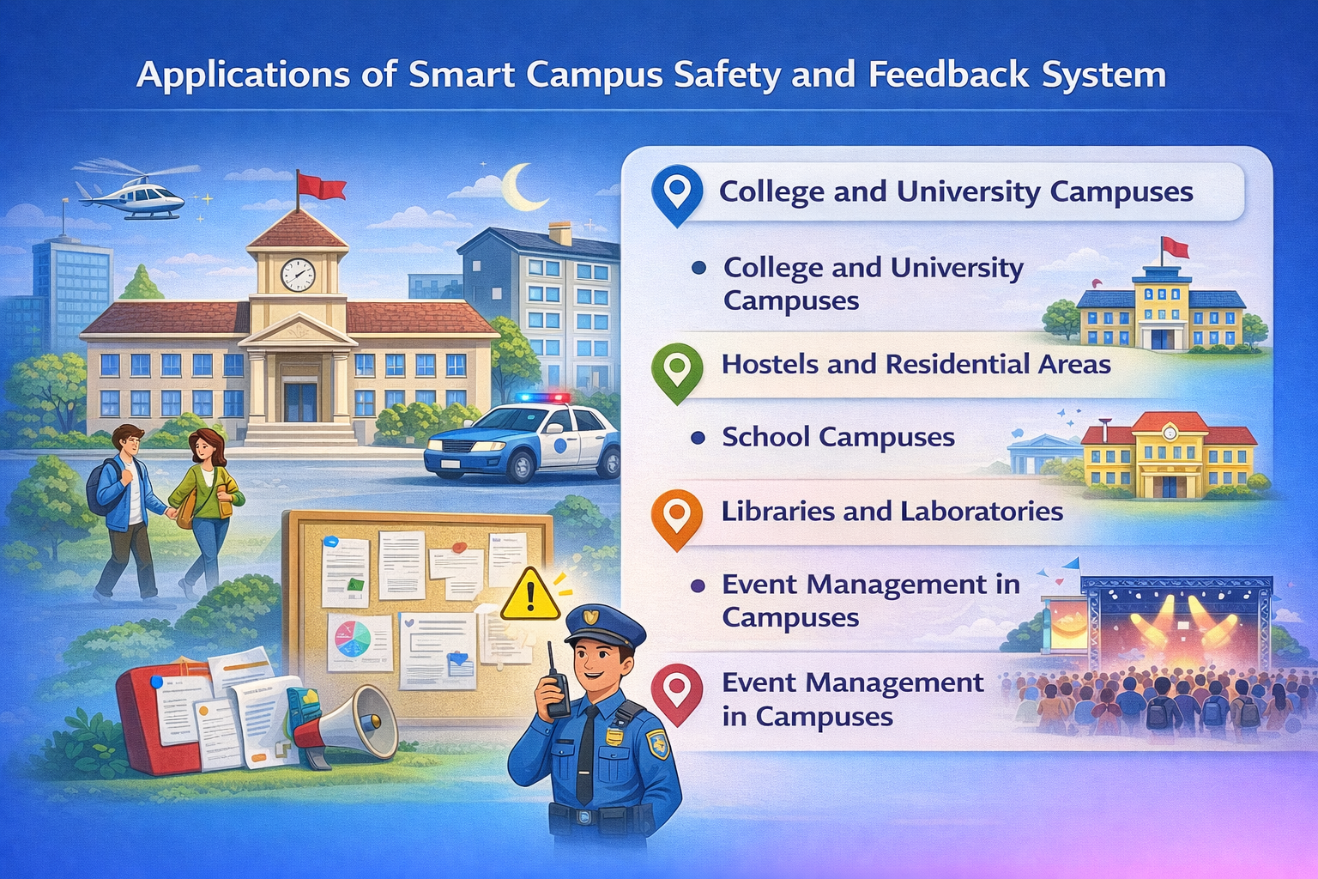

Slide 20
FUTURE SCOPE
Integrate a mobile app for real-time safety alerts and feedback.
Use AI, CCTV, and GPS tracking for smarter and faster campus security.

Slide 21
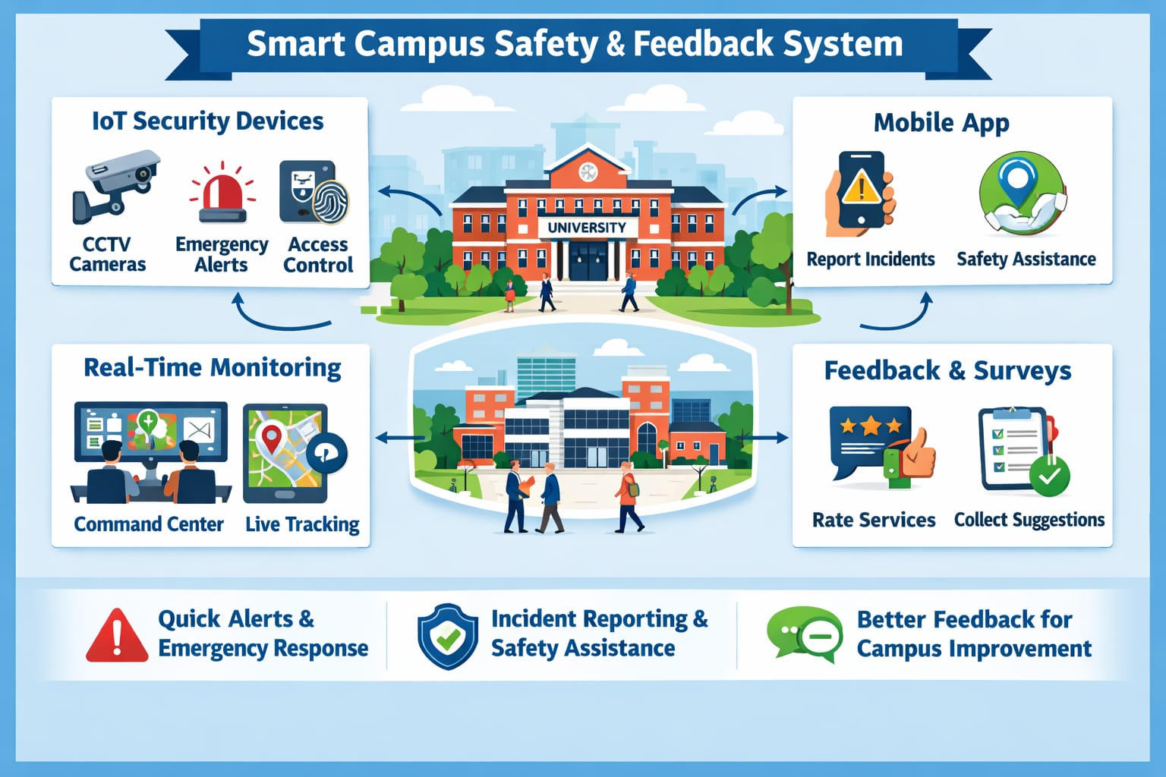

Slide 22
CONCLUSION
Enables real-time reporting of safety incidents on campus.
Provides instant alerts to authorities for faster response.
Allows students and staff to actively participate in campus safety.
Reduces emergency response time and enhances overall security.
Collects feedback to continuously improve campus safety measures

Slide 23
REFERENCES OF PRIVIOUS JOURNAL PAPERS
1. R. Kumar, S. Priya, A. Sharma “Smart Campus Safety and Feedback System: A Digital Approach” International Journal of Engineering Research and Technology (IJERT), Vol. 12, Issue 04, April 2023.
2. M. Reddy, N. Lakshmi “An Integrated Smart Campus Safety System Using Web Technologies” International Journal of Advanced Research in Computer Science and Software Engineering (IJARCSSE), Vol. 11, Issue 06, June 2022.
3. P. Singh, R. Mehta “Digital Feedback Systems for Enhancing Campus Safety and Student Engagement” International Journal of Innovative Research in Computer Science and Engineering (IJIRCSE), Vol. 9, Issue 02, February 2021.
4. L. Chen, Y. Wang “Smart Campus Safety Monitoring and Feedback Management System” International Journal of Computer Applications, Vol. 175, No. 28, March 2020.

Slide 24
THANK YOU

